Slide 1

Cubit Coding Center
Coders Foundry

Slide 2
Outlines
Goal & Mission
What you will learn?
Assessment tools
Specialized Jobs (Job Title)
What we expect from you?

Slide 3
Goal and Mission

Slide 4
We have one goal and that is to discover, train and graduate a job-market-ready talented software developers in highly specialized domains including and not limited to:
Web Development
Mobile Development
Data Analyst
DevOps Engineer/ Infrastructure Developer
AI and Machine learning Specialist
Game Developer
Computer Security Engineer
Quality Assurance Engineers

Slide 5
What you will learn?

Slide 6






Programming Languages

Slide 7



Database

Slide 8


Version Control

Slide 9


Issue Tracker

Slide 10

Help & Support

Slide 11







Team and Productivity Tools

Slide 12
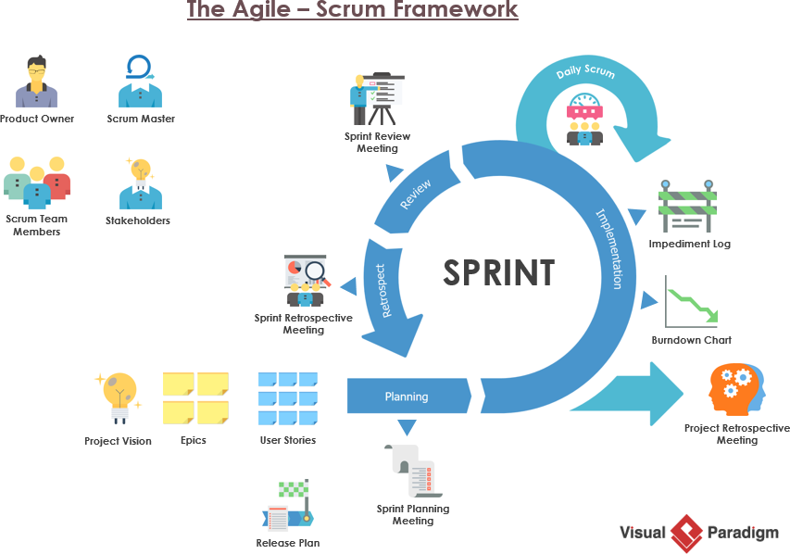
Software development:

Slide 13
Abstract programming concepts
Design Pattern
Creational
Structural
Behavioral
Software architecture patterns
Layered Architecture
Event-Driven Architecture
Microkernel Architecture
Microservices Architecture Pattern
Space-Based Architecture

Slide 14
Assessment Platforms

Slide 15







Slide 16
Specialized Jobs

Slide 17




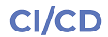
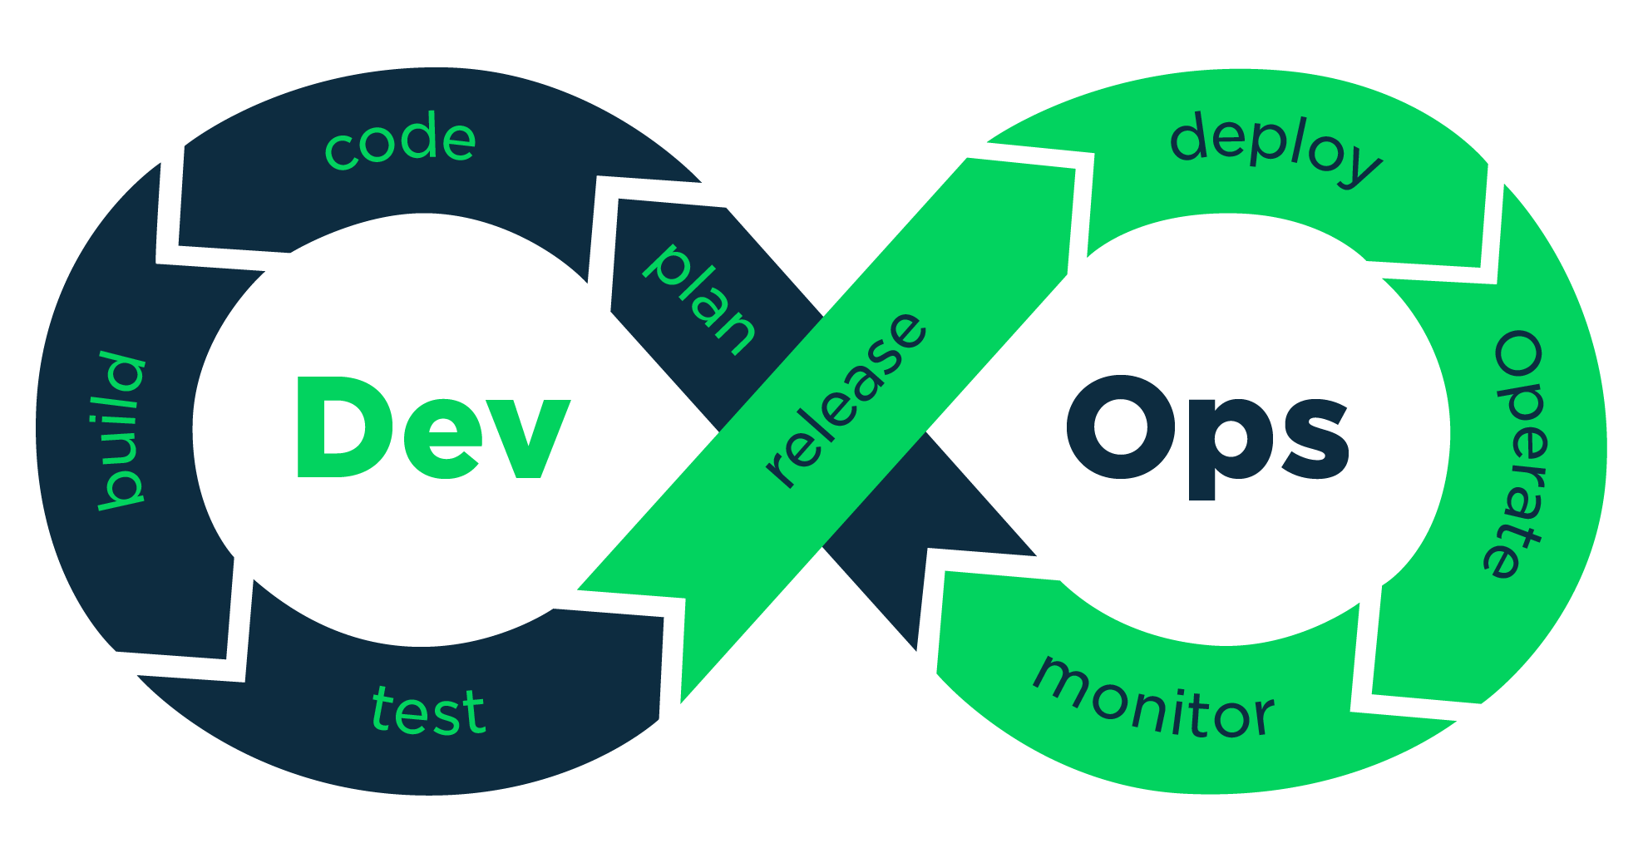


DevOps Engineer/ Infrastructure Developer

Slide 18



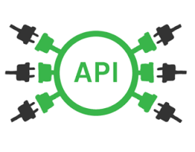


Full-Stack Web Developer

Slide 19
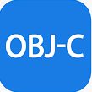


Mobile Developer

Slide 20
What we expect from you?

Slide 21
What we expect from you?
Hard work
Self-learning
Motivation
Serious time commitment
Consistency

